Slide 1
Project: Virtual Queue 2.0 Student: Kenneth Kon Michael Lazo Mentor: Bernard Parenteau
Sprint 5
CIS 4911 Senior Project
School of Computing and Information Sciences
Florida International University
<4/20/2015>

Slide 2
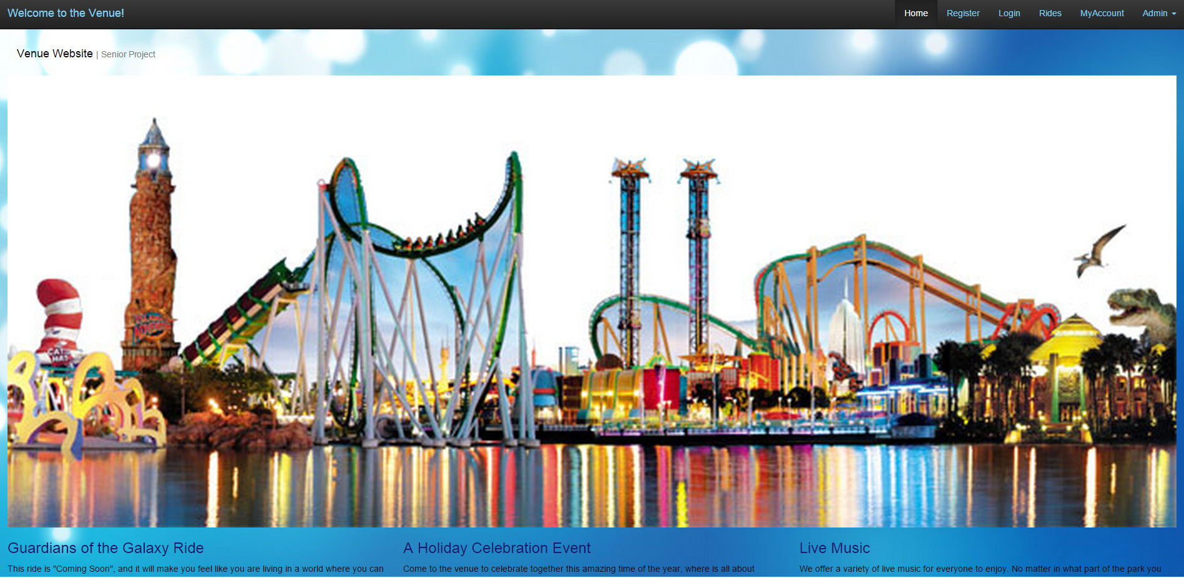
Virtual Queue
Notes:
Explain the scope of the project. What it is. Target client.

Slide 3
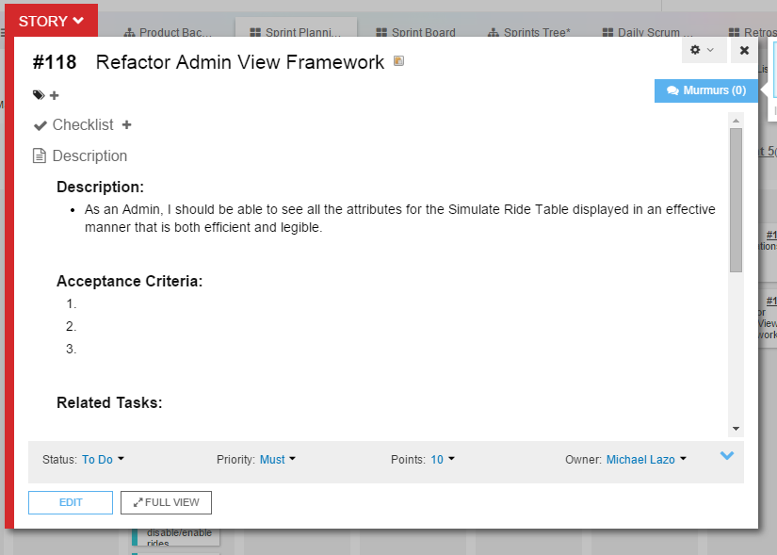
User Story

Slide 4
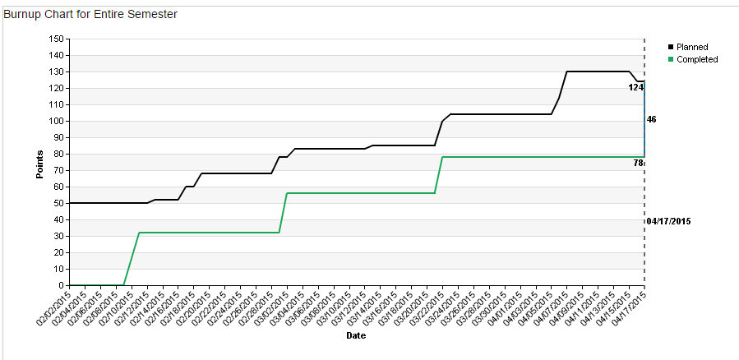
Burn-up/Burn-down charts

Slide 5
Daily Scrums
Daily Scrum 1-2
Work on the corresponding Use Case, Sequence, and Class diagrams
Daily Scrums 3-8
Work on Refactoring previous sprint implementations, in order to make the project scalable to future versions
Daily Scrums 9-10
Review UML diagrams to apply any changes found while implementing, meet with product owner for acceptance

Slide 6
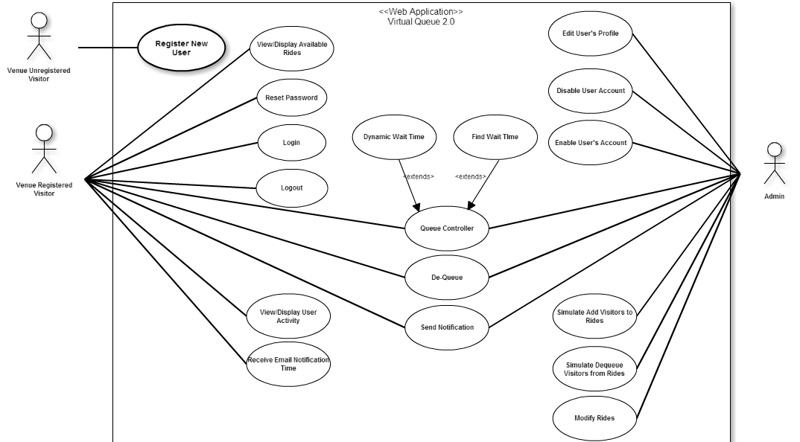
Changes to Design Doc

Slide 7
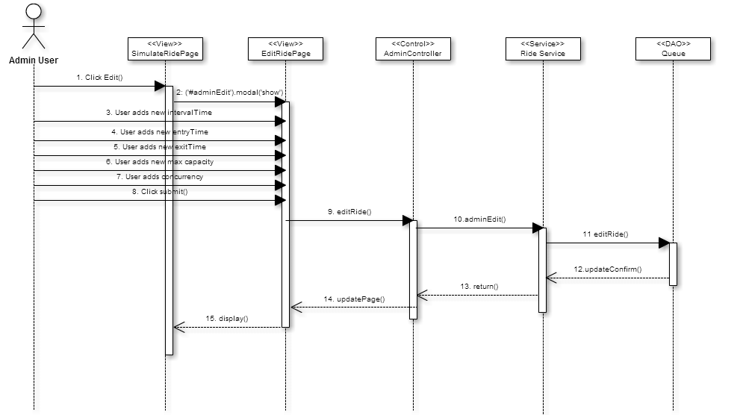
Changes to Design Doc
adminEdit

Slide 8
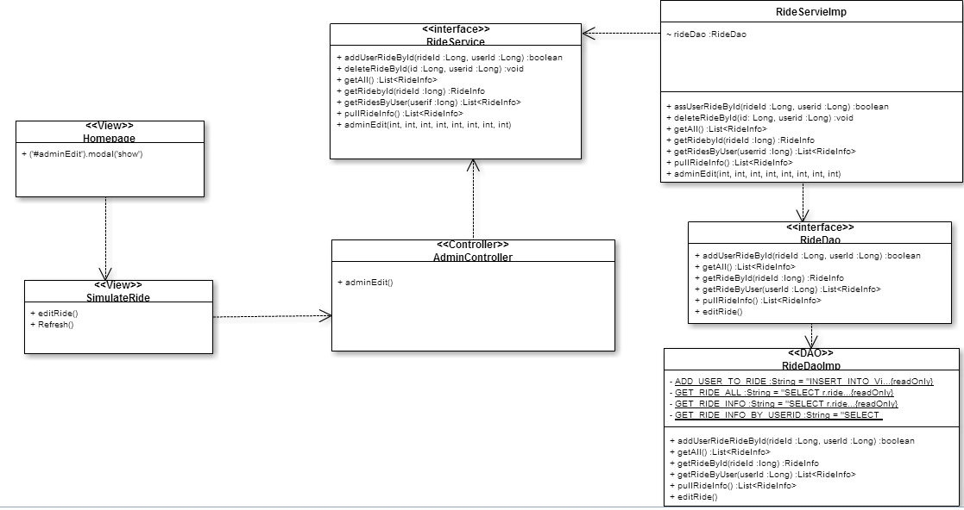
Changes to Design Doc

Slide 9
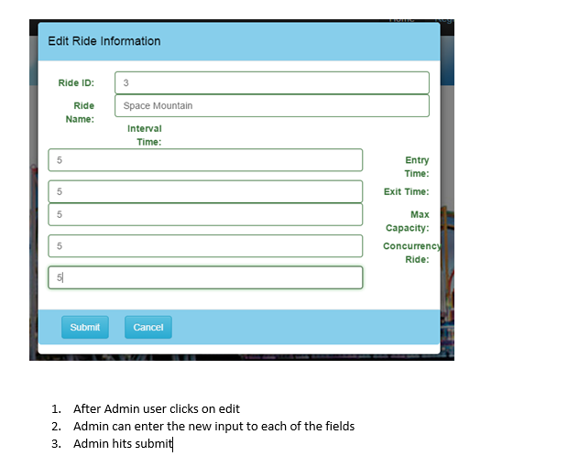
Changes to User Manual

Slide 10
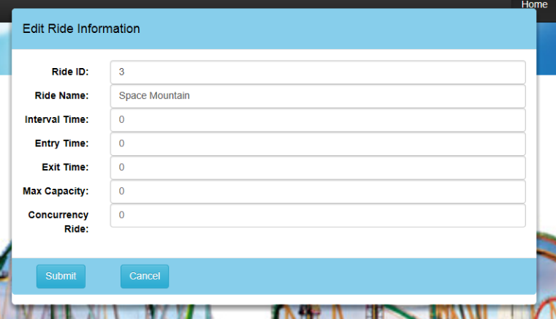
Changes to User Manual

Slide 11
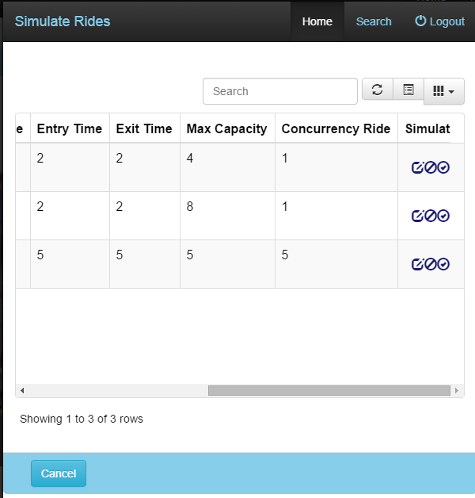
Changes to User Manual

Slide 12
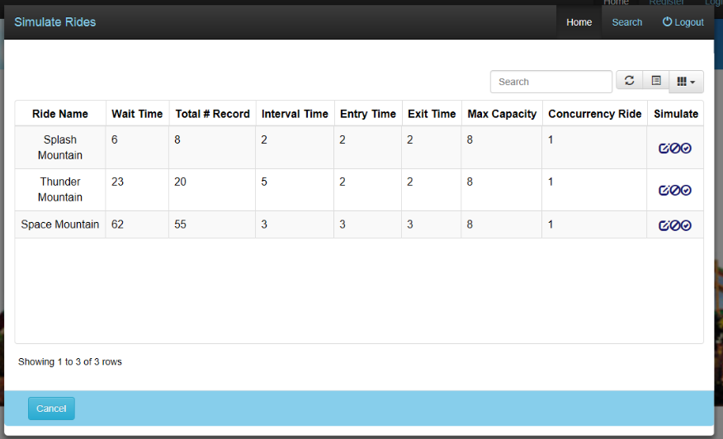
Changes to User Manual

Slide 13
Demo

Slide 14
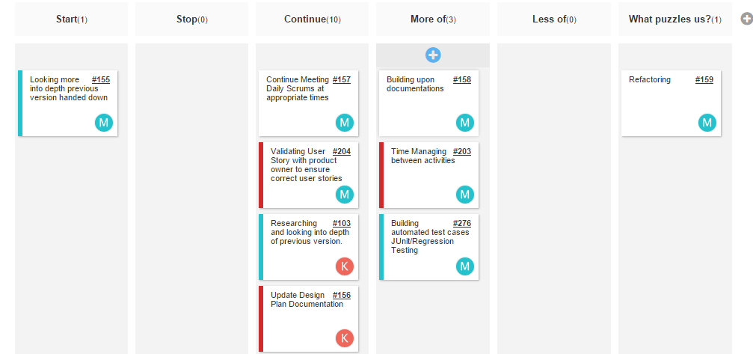
Retrospectives

Slide 15
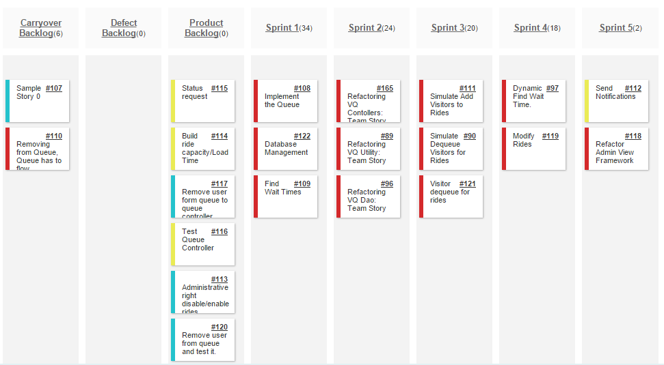
Sprint Review

